Slide 1
How to diffuse your way out of a paper bag
Feb 2019
Frances Buontempo
@fbuontempo
https://pragprog.com/book/fbmach/genetic-algorithms-and-machine-learning-for-programmers

Slide 2
Objectives
Think about randomness
Think about testing
Draw pictures in C++
Encourage you to investigate machine learning
Send articles to Overload@ACCU.org
…or have a fun pet project #CodeYourWay
Actually…

Slide 3
Code your way out of a paper bag!

Slide 4
“We're tired of talking to candidates who can't program their way out of a paper bag.”
Jeff Atwood, co-founder of Stack Overflow https://blog.codinghorror.com/why-cant-programmers-program

Slide 5
Previously: Rule induction ACCU 2013
Name | Inputs | Learning | instance-based (lazy) learning | Randomness | Output | Escape Paper Bag?
regression | numeric | supervised | false | no | Numeric | no
k-th nearest neighbours | numeric | unsupervised | true | no | data points | no
kohonen neural network | numeric | unsupervised | false | no | Clusters | no
feedforward nn | numeric | supervised | false | no | Numeric | no
recurrent nn (eg Hopfield) | binary | reinforcement | true | no | State | no
C4.5 or See5 | categoric | supervised | false | no | decision tree | no
CART | any | supervised | false | no | Tree | no
genetic algorithm | any | unsupervised | false | yes | Solution | yes
dendral | numeric | hypothesis formation | false | no | expert system (possible chemical structures) | no
ACO | spatial | unsupervised | false | yes | best 'path' | yes

Slide 6
Did you notice?
Randomness?
Yes
No
Suitable
No suitable
C4.5 from https://www.rulequest.com/

Slide 7
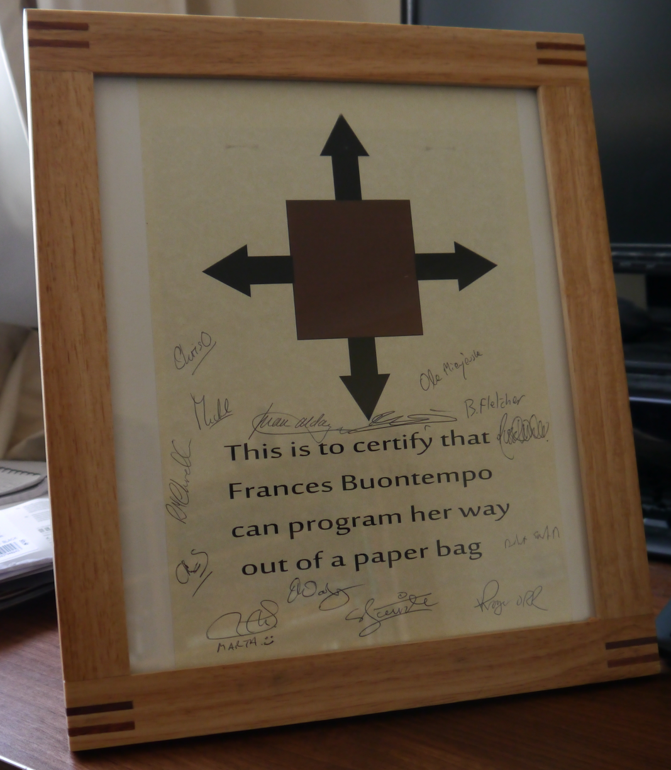
Award!

Slide 8
Previously…
Over-engineered – using machine learning
Ant Colony Optimisation
http://accu.org/content/conf2013/Frances_Buontempo_paperbag.pdf
Genetic algorithms
http://accu.org/index.php/journals/1825
Particle swarm optimisation
http://accu.org/index.php/journals/2023

Slide 9


Slide 10
Now…
Approaches used randomness
Some need a model
Time for Monte Carlo simulation(s)
Generate a few possible results
See what happens
Average the results to get an answer
Or find worst case scenarios

Slide 11
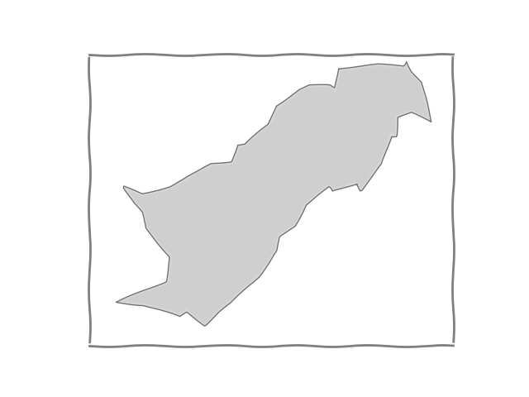
What’s MC good for?
What’s the area in the squiggle?

Slide 12
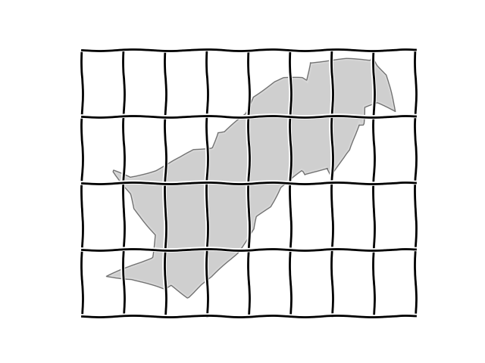
Intractable, but guestimateable
Some not empty, so area > 0%
~20 not empty, so < 20/32 or 62.5% of big rectangle

Slide 13
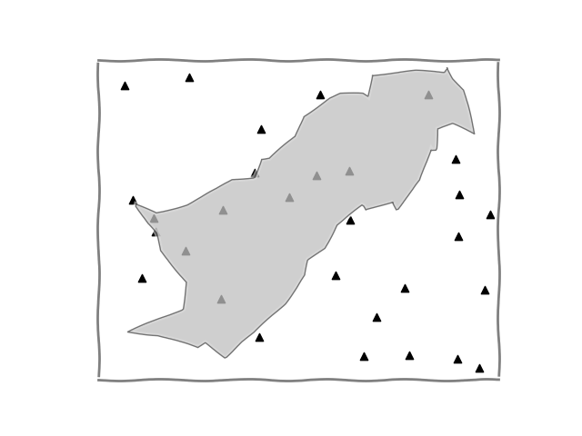
Sampling
“Throw darts” 10 out of 30 in blob, so approx. 30% of the rectangle’s area

Slide 14
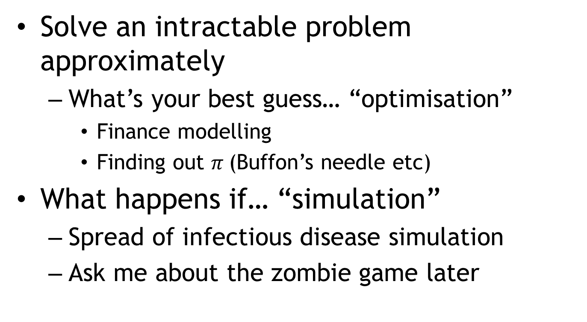
Simulate and see
Solve an intractable problem approximately
What’s your best guess… “optimisation”
Finance modelling
Finding out $π$(Buffon’s needle etc)
What happens if… “simulation”
Spread of infectious disease simulation
Ask me about the zombie game later

Slide 15
Monte Carlo simulation
Invented in the late 1940s by Stanislaw Ulam, while he was working on nuclear weapons projects at the Los Alamos National Laboratory.
http://en.wikipedia.org/wiki/Monte_Carlo_method
Actually, casinos, cards…. MONTE CARLO

Slide 16
Card sharks…
… a question which occurred to me in 1946 as I was convalescing from an illness and playing solitaires.
…what are the chances that a Canfield solitaire laid out with 52 cards will come out successfully?
After spending a lot of time trying to estimate them by pure combinatorial calculations, I wondered whether a more practical method than "abstract thinking" might not be to lay it out say one hundred times and simply observe and count the number of successful plays.
This was already possible to envisage with the beginning of the new era of fast computers, and I immediately thought of problems of neutron diffusion and other questions of mathematical physics.
http://en.wikipedia.org/wiki/Monte_Carlo_method

Slide 17
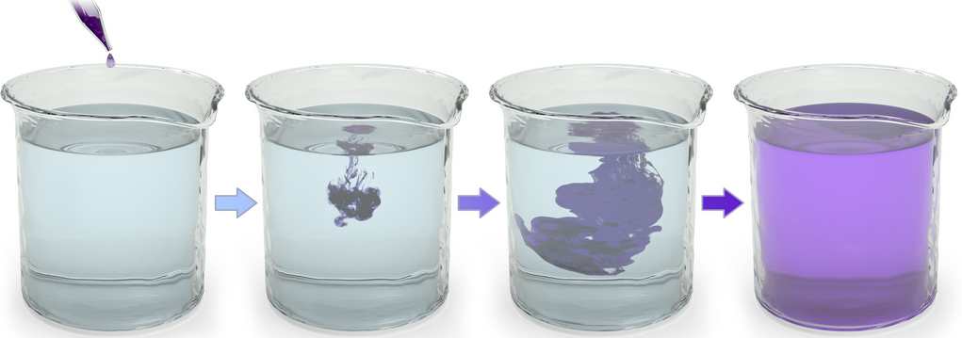
Finally, diffusion!
Latin diffusionem ‘a pouring forth’,
In gas, water, solid
All about things spreading out

Slide 18
Coming up
Brownian motion
Geometric Brownian motion
Jump diffusion

Slide 19
What’s this got to do with paper bags?
Use a model (differential equation)
Brownian motion to get blobs out of a paper bag
Questions
Can we go off the screen?
Can we bust out the bottom or side of the bag?
What bag?
Level of indirection…
What colour is it anyway?

Slide 20


Level of indirection

Slide 21
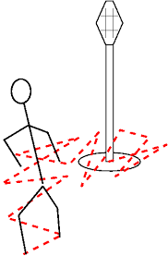
Model: a random walk
http://www.physics.ucla.edu/~chester/TECH/RandomWalk/
http://en.wikipedia.org/wiki/Random_walk

Slide 22
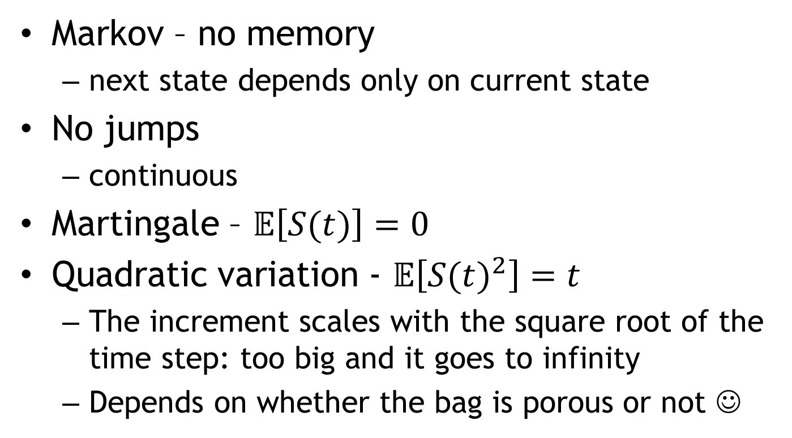
Brownian motion
Markov – no memory
next state depends only on current state
No jumps
continuous
Martingale – $𝔼\left[S(t)\right]=0$
Quadratic variation - $𝔼\left[{S(t)}^{2}\right]=t$
The increment scales with the square root of the time step: too big and it goes to infinity
Depends on whether the bag is porous or not ☺
Notes:
http://www.mit.edu/~kardar/teaching/projects/chemotaxis(AndreaSchmidt)/random.htm

Slide 23
Brownian motion in English
Walking, one step at a time
With varying step sizes
E.g. drawn from a Normal (or Gaussian) distribution
Every which way
All equally likely
Like a “drunkards walk”
no memory! (Markov)

Slide 24
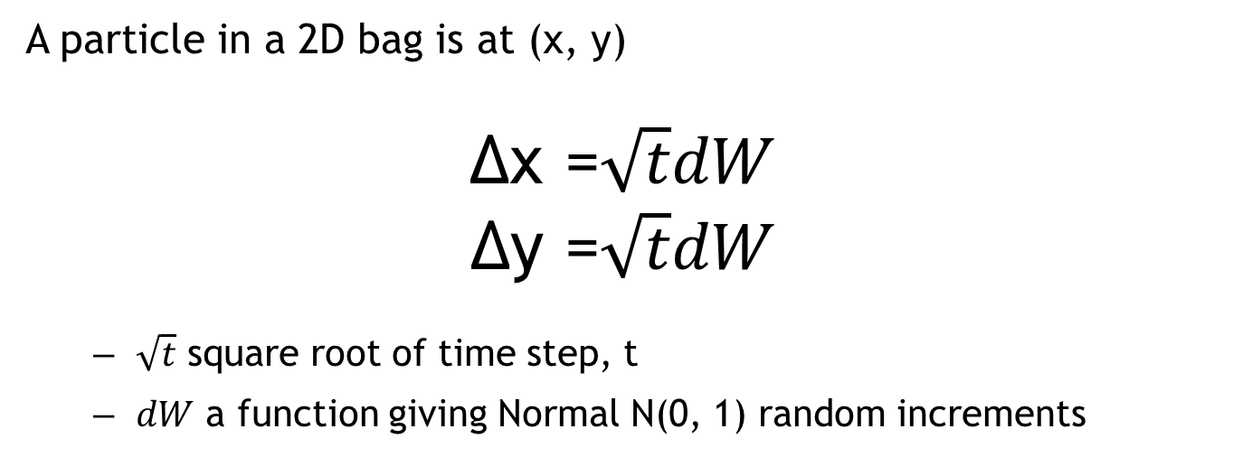
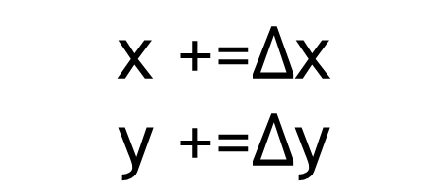
Maths
A particle in a 2D bag is at (x, y)
$$\text{Δ}\text{x}\text{ =}\sqrt{t}dW$$
$$\text{Δ}\text{y}\text{ =}\sqrt{t}dW$$
$\sqrt{t}$ square root of time step, t
$dW$ a function giving Normal N(0, 1) random increments
$$\text{x}\text{ +=}\text{Δx}$$
$$\text{y}\text{ +=}\text{Δy}$$
Page 265 John C. Hull “Options, Futures and other Derivatives.” 6th Edition

Slide 25
Random increment
Stochastic *means* random(ish)
rand
Uniform random
Normal random
What is a Mersenne twister anyway?

Slide 26
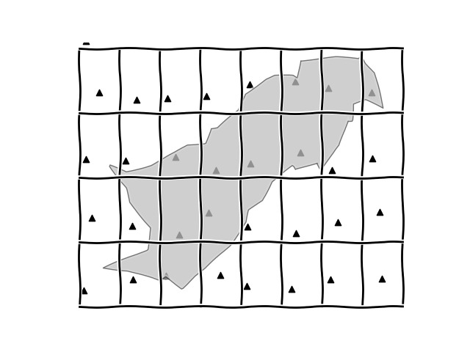
Why random?
Low discrepancy numbers instead …

Slide 27
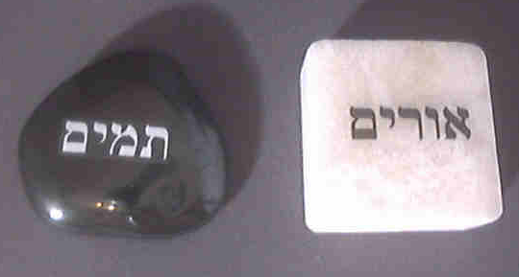
God does not play dice*
Deterministic random number generators…
*Except in the movies and our current physics models

Slide 28
How do I get a random number?
int GetRandom()
{
return 59;
//A perfectly randomly
// picked number
}
http://stackoverflow.com/questions/4195958/how-do-i-scale-down-numbers-from-rand
(Also, https://www.theregister.co.uk/2019/01/23/verity_stob_diary_of_metropolitan_techie/ )

Slide 29
Beware C’s rand!
No good for serious random-number generation
Implementation-defined whether it’s is thread-safe
Considered harmful - http://channel9.msdn.com/Events/GoingNative/2013/rand-Considered-Harmful
“Some pseudo random number generators lead to inconsistent results in random walk simulations”
Ferrenberg affair: see http://www.academia.edu/4222855/Pseudo_Random_Coins_Show_More_Heads_Than_Tails

Slide 30
How do I get a number in [0, 100]?
int value = rand() % 100;
int value = (rand() * 1.0/RAND_MAX) * 100;
int value;
do {
value = rand();
} while (value > 100);

Slide 31
rand() % 100
Oops…
Value | Freq
100 | 0

Slide 32
(rand() * 1.0/RAND_MAX) * 100
Oops…I did it again
Value | Freq
100 | 0

Slide 33
Rejection sampling
Value | Freq
100 | 94

Slide 34
So what?
Dice rolling… [1, 6] doing [0, 6) then add 1:
((rand() * 1.0/RAND_MAX) * 6) + 1;
Bin | Frequency
1 | 1722
2 | 1644
3 | 1676
4 | 1651
5 | 1664
6 | 1643
Bonus Question – can this ever be 7?

Slide 35
New, improved
#include <random>
std::random_device rseed;
std::mt19937 rgen(rseed()); // mersenne_twister
std::uniform_int_distribution<int> dist(0,100);
int value = dist(rgen);
Value | Freq
100 | 104

Slide 36
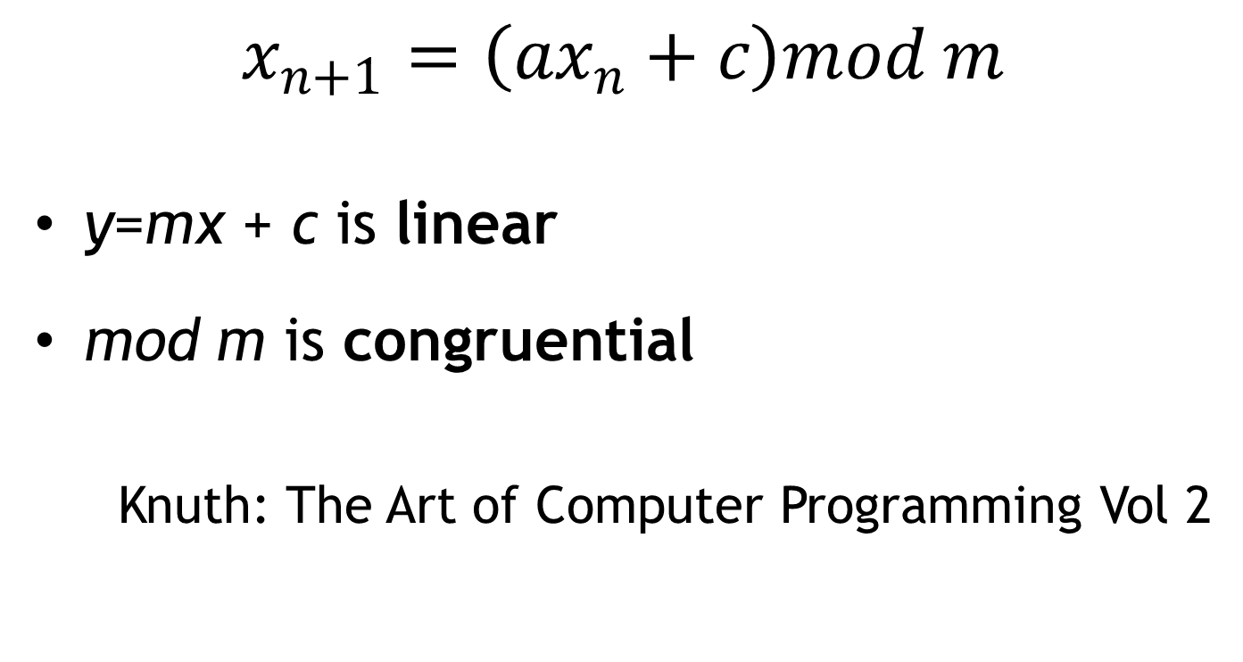
Linear congruential
$$x_{n+1}=\left({ax}_{n}+c\right)mod m$$
y=mx + c is linear
mod m is congruential
Knuth: The Art of Computer Programming Vol 2

Slide 37
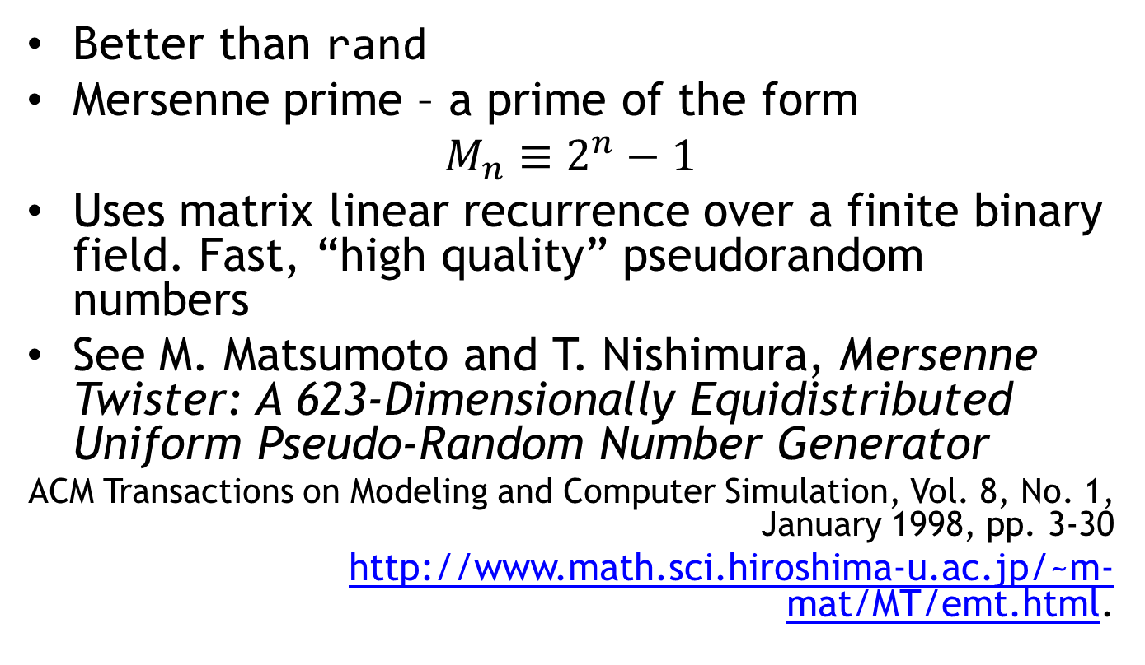
Mersenne twister
Better than rand
Mersenne prime – a prime of the form
$$M_{n}≡2^{n}−1$$
Uses matrix linear recurrence over a finite binary field. Fast, “high quality” pseudorandom numbers
See M. Matsumoto and T. Nishimura, Mersenne Twister: A 623-Dimensionally Equidistributed Uniform Pseudo-Random Number Generator
ACM Transactions on Modeling and Computer Simulation, Vol. 8, No. 1, January 1998, pp. 3-30
http://www.math.sci.hiroshima-u.ac.jp/~m-mat/MT/emt.html.

Slide 38
‘It sounds like a jet coaster’
Originally called “Primitive Twisted Generalized Feedback Shift Register Sequence”
Knuth said “The name is a mouthful”
Reply: “How about Mersenne Twister? Since it uses Mersenne primes, and it shows that it has its ancestor Twisted GFSR.”

Slide 39
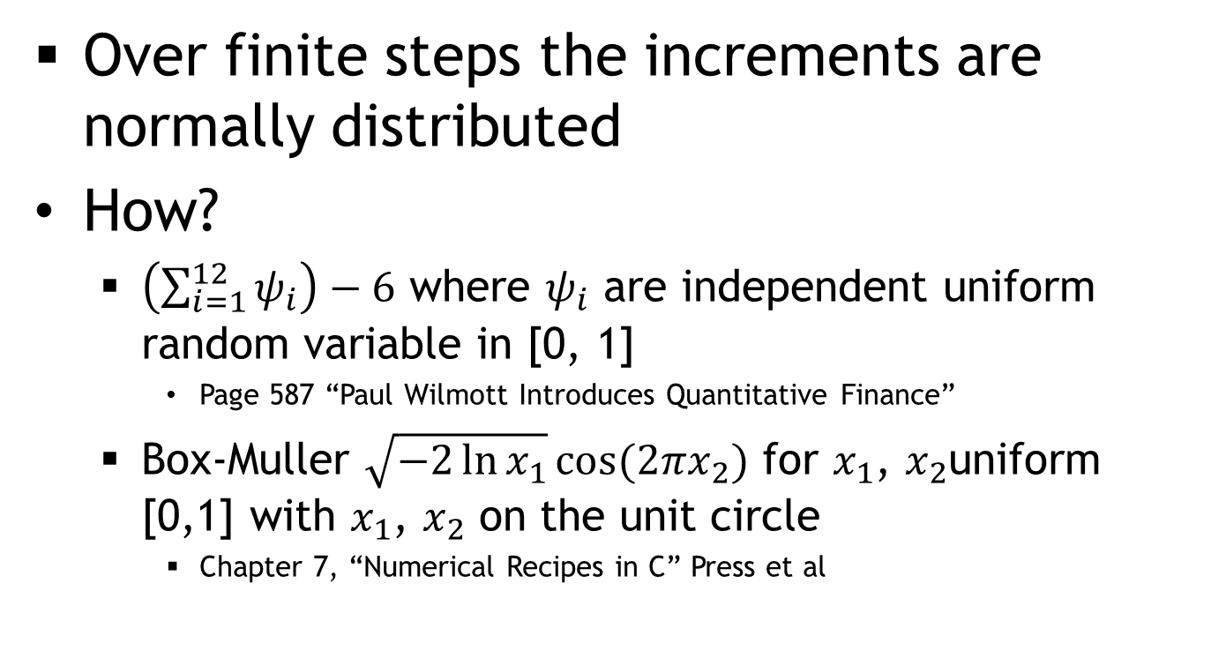
We want Normal random numbers
Over finite steps the increments are normally distributed
How?
$\left(\sum_{i=1}^{12}{ψ_{i}}\right)−6$ where $ψ_{i}$ are independent uniform random variable in [0, 1]
Page 587 “Paul Wilmott Introduces Quantitative Finance”
Box-Muller $\sqrt{−2\ln{x_{1}}}cos⁡(2πx_{2})$ for $x_{1}$, $x_{2}$uniform [0,1] with $x_{1}$, $x_{2}$ on the unit circle
Chapter 7, “Numerical Recipes in C” Press et al

Slide 40
C++11, simples
std::random_device rseed;
std::mt19937 rgen(rseed());
std::normal_distribution<double> dist;
int value = dist(rgen);
std::random_device is a uniformly-distributed integer random number generator that produces non-deterministic random numbers.
std::random_device may be implemented in terms of an implementation-defined pseudo-random number engine if a non-deterministic source (e.g. a hardware device) is not available to the implementation. In this case each std::random_device object may generate the same number sequence.
http://en.cppreference.com/w/cpp/numeric/random/random_device

Slide 41
Finally, some code
class Air
{
std::mt19937 engine;
std::normal_distribution<float> normal_dist;
const float step;
public:
Air(float step, unsigned int seed = 1) :
step(step),
engine(seed)
{
}
float Bump()
{
return step * normal_dist(engine);
}
};

Slide 42
class Particle
{
public:
Particle(float x = 0, float y = 0) : x(x), y(y)
{
}
void Move(float x_step, float y_step)
{
x += x_step;
y += y_step;
}
float X() const { return x; }
float Y() const { return y; }
private:
float x;
float y;
};

Slide 43
Now for some pictures…
#include <SFML/Graphics.hpp> // http://www.sfml-dev.org/
int main() {
sf::RenderWindow window(sf::VideoMode(800, 600), "My window");
while (window.isOpen()) {
// check all the window's events
sf::Event event;
while (window.pollEvent(event)) {
// "close requested" event: we close the window
if (event.type == sf::Event::Closed)
window.close();
}
window.clear(sf::Color::Black);
// draw everything here...
// window.draw(...);
window.display();
}
}

Slide 44
bool paused = false;
while (window.isOpen()) {
sf::Event event;
while (window.pollEvent(event)) {
if (event.type == sf::Event::Closed)
window.close();
if (event.type == sf::Event::KeyPressed)
paused = !paused;
}
window.clear();
drawBag(window, left, right, base); //Uses 3 sf::RectangleShape
sf::CircleShape shape(lineWidth);
shape.setFillColor(sf::Color::Green);
for(auto & particle: particles) {
if (!paused)
particle.Move(air.Bump(), air.Bump());
shape.setPosition(particle.X(), particle.Y());
window.draw(shape);
}
window.display();
}

Slide 45
Action…
(Note to self – do a demo)

Slide 46
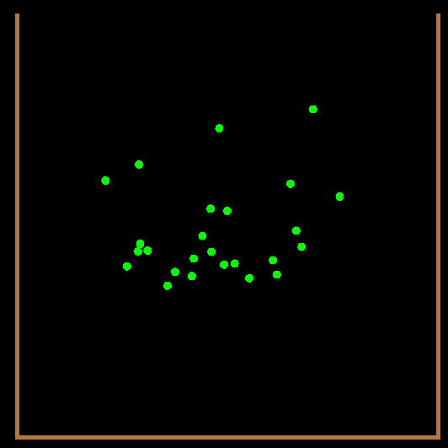
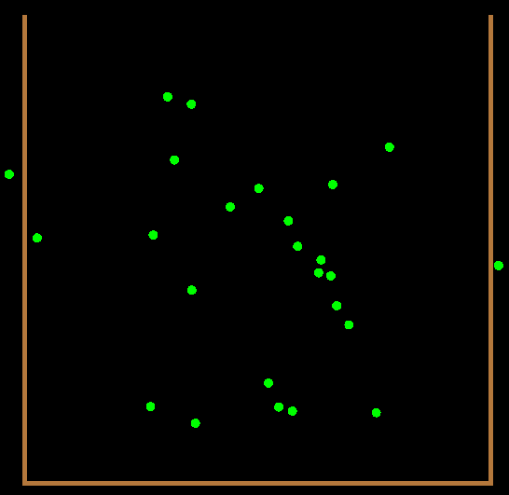
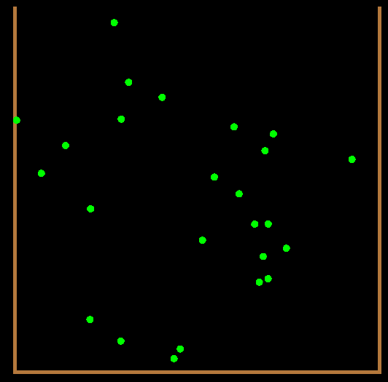
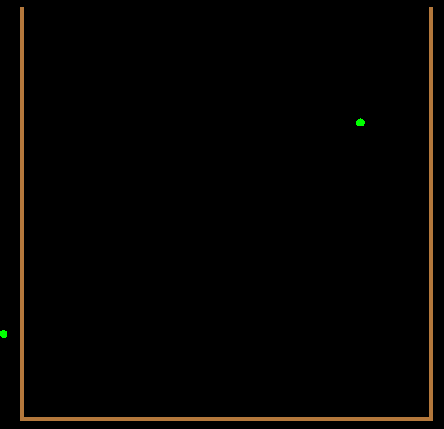
Eventually…

Slide 47
Question
Can the particles go through the side of the bag?
Should they be allowed back in again?

Slide 48
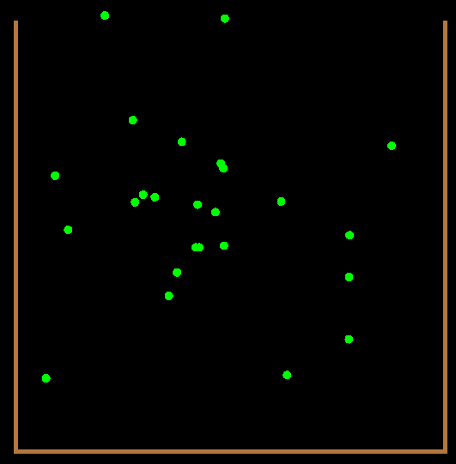
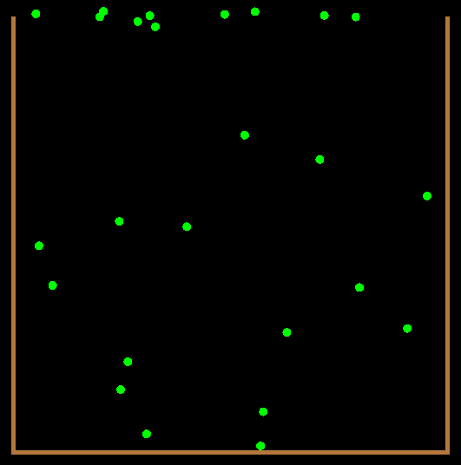
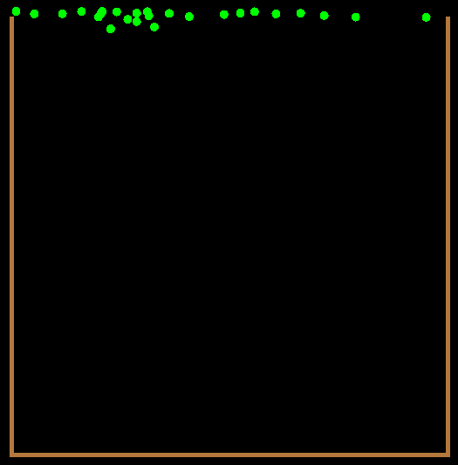
Non-permeable

Slide 49
Assumptions
The paper bag is “permeable” – at least not full of concrete
This is conducted above absolute zero
I assume some particles escaping is good enough – they do all eventually go… eventually

Slide 50
Stop hacking and think
It takes a..g..e..s..
Can I just set fire to the bag? Not today.
We want to mostly go up.
Stock prices (almost) always go up, right?
Let’s try something different
A stock price simulation

Slide 51
But where’s the paper bag?
Level of indirection
Put the stock price simulation in a bag
New model: Geometric Brownian motion
A little more complicated than Brownian motion

Slide 52
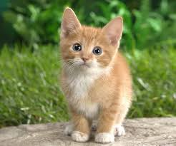
Gratuitous Kitten Picture

Slide 53
Stock prices
Supply/demand
“Not a prediction, but a convention” Keynes
So let’s predict them using Monte Carlo simulations
Need a model - GBM
Based on the “efficient market hypothesis” i.e. it’s impossible to “beat the market” or make money from it.
http://www.investopedia.com/articles/07/montecarlo.asp

Slide 54
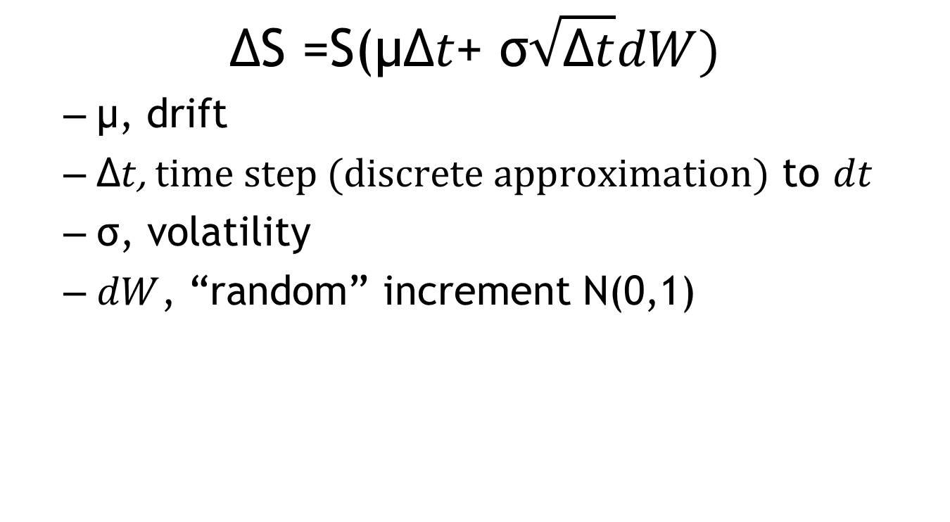
Model: Geometric Brownian motion
$$\text{ΔS}\text{ =}\text{S}\text{(}\text{μ}\text{Δ}t\text{+ }\text{σ}\sqrt{\text{Δ}t}dW)$$
$\text{μ}$, drift
$\text{Δ}t$, $time step (discrete approximation)$ to $dt$
$\text{σ}$, $\text{volatility}$
$dW$, “random” increment N(0,1)

Slide 55
What values to use?
Drift
risk free rate?
LIBOR rate?
Volatility
historical?
backed out (implied) from current prices?
GARCH models?
Make it up ☺

Slide 56
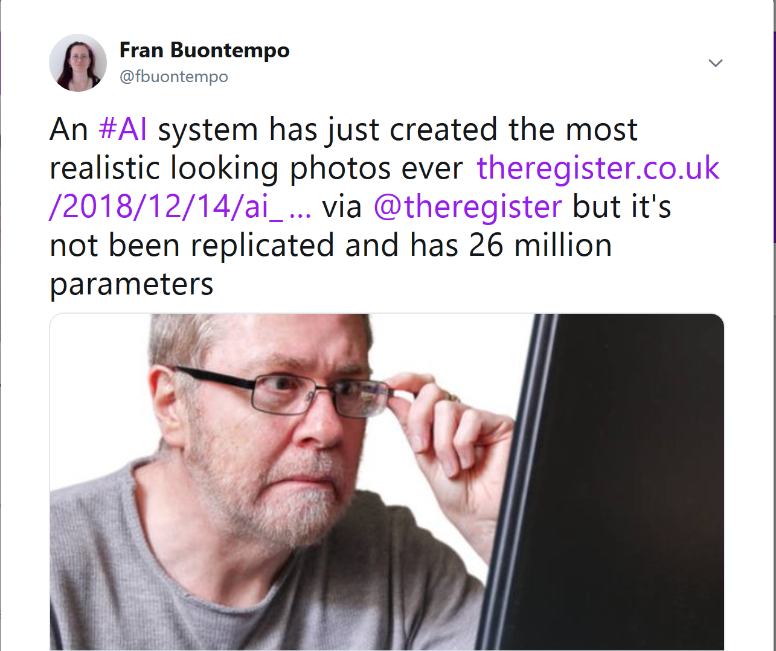

Slide 57
Finally, some code
class PriceSimulation {
public:
PriceSimulation(double price, double drift, double vol,
double dt, unsigned int seed);
double update();
private:
std::mt19937 engine;
std::normal_distribution<> normal_dist;
double price;
double drift;
double vol;
double dt;
};

Slide 58
Update
double PriceSimulation::update()
{
double stochastic = normal_dist(engine);
double increment =
drift * dt + vol * sqrt(dt) * stochastic;
price += price * increment;
return price;
}

Slide 59
Things can go wrong
What seed to use?
Older VS’s didn’t accept 0
https://connect.microsoft.com/VisualStudio/feedback/details/776456
Should each price simulation have its own generator?
Using “now” in a tight loop is a Bad Idea
unsigned int seed = std::chrono::high_resolution_clock::
now().time_since_epoch().count();
std::random_device can be a bad idea

Slide 60
How do we test this?
#define CATCH_CONFIG_MAIN
#include <catch.hpp> //https://github.com/philsquared/Catch.git
#include <random>
#include "../Lib/PriceSimulation.h"
TEST_CASE("Test that random numbers have mean 0", "[Simples]")
{
std::mt19937 engine;
std::normal_distribution<> normal_dist;
REQUIRE(normal_dist.mean() == 0.0);
}
TEST_CASE("Test that random numbers have standard deviation 1", "[Simples]")
{
std::mt19937 engine;
std::normal_distribution<> normal_dist;
REQUIRE(normal_dist.stddev() == 1.0);
}

Slide 61
Or…
TEST_CASE("Test that stock price simulation starting at 0 remains at 0", "[Property]")
{
const double start_price = 0.0;
const double dt = 0.1;//or whatever
const unsigned int seed = 1; //or whatever
MC101::PriceSimulation price(
start_price, 0.3, 0.2, dt, seed);
REQUIRE(price.update() == 0.0);
}

Slide 62
Recurse
Should I randomly seed the seed?
Randomly generate the numbers that don’t matter?
Can I use Monte-Carlo simulations to test my simulation code?
YES!!!!!

Slide 63
Go on then
Property based testing
AKA “axiom based” or “specification based” testing
QuickCheck (Haskell), ScalaCheck, FsCheck, Hypothesis (Python)
Can get abstract quickly – e.g. concepts and axioms: http://www.jot.fm/issues/issue_2011_01/article10.pdf

Slide 64
Test properties
Test that stock price simulation starting at 0 remains at 0
Test that the returns have the requested drift, …
Avoids “magic” numbers
Find edge cases you hadn’t thought of
Potential unit tests

Slide 65
QuickCheck
#include "quickcheck/quickcheck.hh" //http://software.legiasoft.com/git/quickcheck.git
#include <vector>
using namespace quickcheck;
typedef std::vector<int> Vector;
class PReverseCancelsReverse : public Property<Vector> {
bool holdsFor(const Vector& xs) {
Vector ys = xs;
reverse(ys.begin(), ys.end());
reverse(ys.begin(), ys.end());
return xs == ys;
}
};
int main()
{
PReverseCancelsReverse revRev;
revRev.check();
}
OK, passed 100 tests.
Falsifiable after 2 tests for input:
0: [-2, 2]

Slide 66
GBM properties
Turning off the “shock” (or vol) gives the drift parameter:
class ZeroVolGivesDrift : public Property<ZeroVolPriceGenerator> {
bool holdsFor(const ZeroVolPriceGenerator& gen) {
…
}
bool accepts(const ZeroVolPriceGenerator& gen) {
…
}
};
int main() {
ZeroVolGivesDrift zeroVol;
zeroVol.check(100);
}

Slide 67
class ZeroVolGivesDrift : public Property<ZeroVolPriceGenerator> {
bool holdsFor(const ZeroVolPriceGenerator& gen) {
//Price returns are normally distributed.
//The *prices* are log normal
std::vector<double> xs = gen.prices();
double tot = 0;
double previous = gen.StartPrice();
for(const auto & p : xs) {
tot += (p - previous)/previous;
previous = p;
}
auto average = tot/xs.size();
return average == gen.Drift(); //or your fav floating point cmp
}
bool accepts(const ZeroVolPriceGenerator& gen) {
return gen.Sims() >= 1 //is 0 ok?
&& gen.Dt() > 0.0
&& std::abs(gen.Drift()) < 20.0;
}
};

Slide 68
void generate(size_t n, ZeroVolPriceGenerator & out)
{
double price;
double drift;
double dt;
int sims;
generate(n, price);
generate(n, drift);
dt = 1;
generate(n, sims);
out.reset(price, drift, dt, sims);
}

Slide 69
Nice #fail messages
std::ostream & operator << (std::ostream & os,
const ZeroVolPriceGenerator & gen) {
os << "Start price " << gen.StartPrice()
<< ", drift " << gen.Drift() << ", dt "
<< gen.Dt() << ", sims " << gen.Sims()
<< '\n';
for(const auto & price : gen.prices())
os << price << '\n';
return os;
}

Slide 70
Action…
(Note to self – do a demo)
StockPricePropertyTest.exe
*and* stock.bat
and variations, e.g stock_no_vol.bat

Slide 71
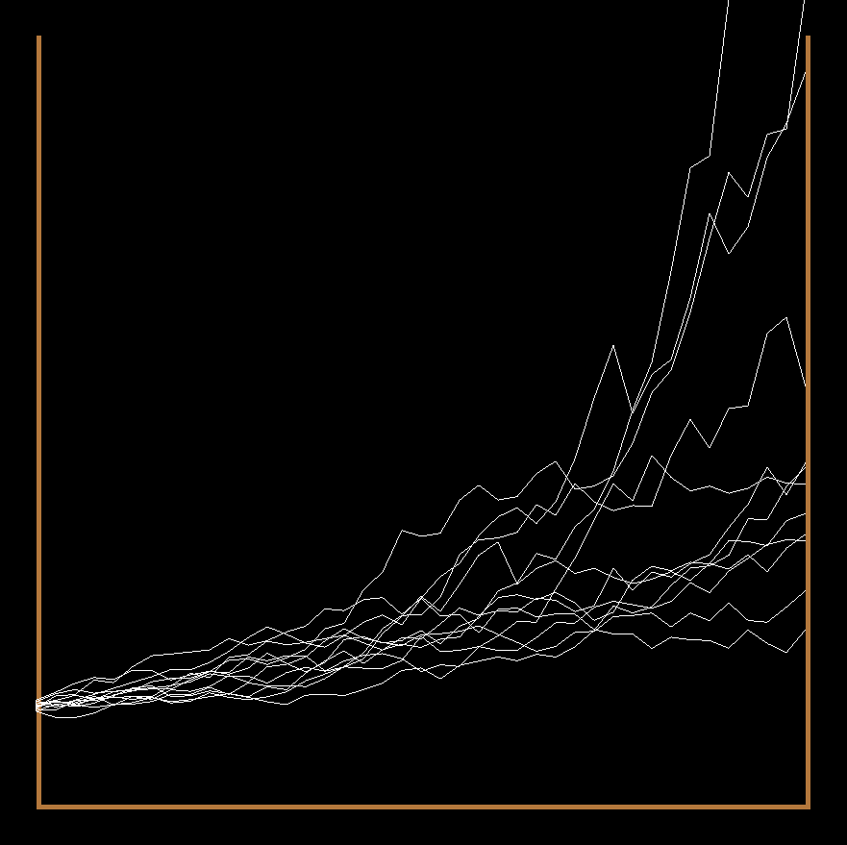
Ta-da!

Slide 72
But…
They don’t always escape.
We could just turn the vol off and amp up the drift.
Or, we could jump…

Slide 73
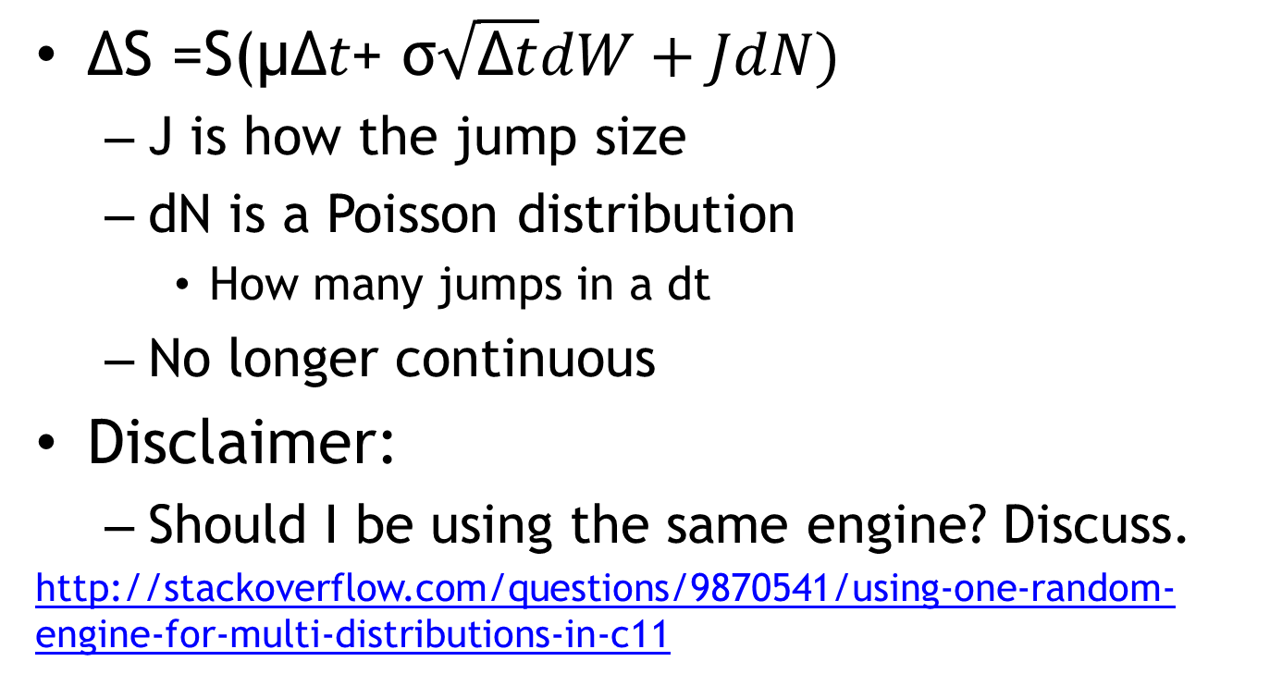
Jump
$\text{ΔS}\text{ =}\text{S}\text{(}\text{μ}\text{Δ}t\text{+ }\text{σ}\sqrt{\text{Δ}t}dW+JdN)$
J is how the jump size
dN is a Poisson distribution
How many jumps in a dt
No longer continuous
Disclaimer:
Should I be using the same engine? Discuss.
http://stackoverflow.com/questions/9870541/using-one-random-engine-for-multi-distributions-in-c11

Slide 74
One* small change
double PriceSimulation::update()
{
double stochastic = normal_dist(engine);
double dn = poisson_dist(engine);
double increment =
drift * dt
+ vol * sqrt(dt) * stochastic
+ jump * dn;
price += price * increment;
return price;
}
* Alright – two – and the poisson_dist member

Slide 75
Action…
(Note to self – do a demo)

Slide 76
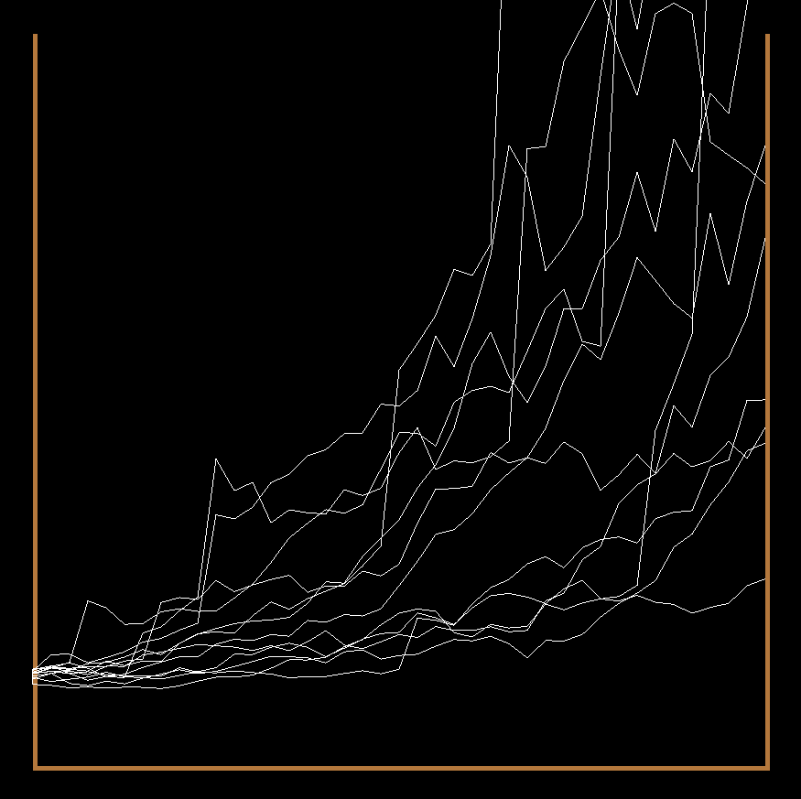
Ta-Da-Da

Slide 77
Possible extensions
3D
Add a heat source
Firework algorithm
See e.g. “Firework algorithm optimisation” James McCaffery https://msdn.microsoft.com/en-us/magazine/dn857364.aspx
Feel free to try programming your own way out of a paper bag

Slide 78
Wrap up
2D Brownian motion is simple to simulate
Provided good N(0, 1) random numbers
Geometric Brownian motion is also simple to simulate
Testing properties might be better than lots of hand rolled tests
rand is hard to use correctly
You can code your way out of a paper bag

